Slide 1

CISC450 Computer Networks
Lesson 2
Digital Data Transmission
Slides courtesy of
William Stallings (mostly)

Slide 2

Standard Codes
Baudot - 5 level code
  Letters/Figures shift
ASCII - 7 level code
EBCDIC - 8 level code
Unicode - 16 bit code for international usage

Slide 3


Parallel and Serial Transmission
HIPPI Interface
Parallel
32/64-bit data path
Uni-directional
800/1600 Mbps
RS-232 Interface
Serial - one line in each
direction
0-20 Kbps

Slide 4
Asynchronous and Synchronous Transmission
Timing problems require a mechanism to synchronize the transmitter and receiver
Two solutions
  Asynchronous
  Synchronous

Slide 5
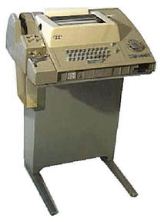
Asynchronous
Data transmitted on character at a time
  5 to 8 bits
Timing only needs maintaining within each character
Resync with each character
ASR-33
Teletype®
110bps
Async

Slide 6
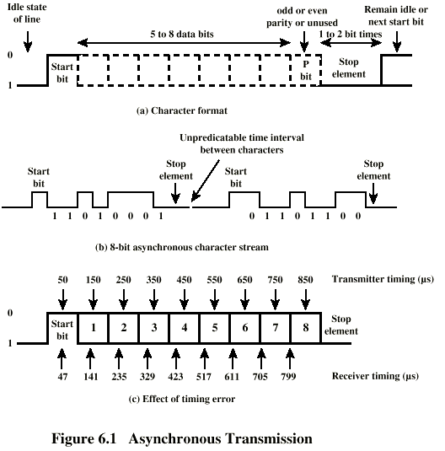
Asynchronous (diagram)

Slide 7
Asynchronous - Behavior
In a steady stream, interval between characters is uniform (length of stop element)
In idle state, receiver looks for transition 1 to 0
Then samples next seven intervals (char length)
Then looks for next 1 to 0 for next char
Simple
Cheap
Overhead of 2 or 3 bits per char (~20%)
Good for data with large gaps (keyboard)

Slide 8

Class Question
What information do you need to convert bits per second into characters per second for an asynchronous device?
  EXAMPLE: The IBM 2741 Communications Terminal used a transmission rate of 134.5 bps. What was its’ throughput in cps?

Slide 9
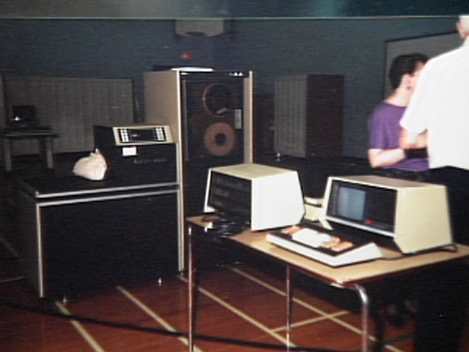
Synchronous - Bit Level
Block of data transmitted without start or stop bits
Clocks must be synchronized
Can use separate clock line
  Good over short distances
  Subject to impairments
Embed clock signal in data

Slide 10
Synchronous - Block Level
Need to indicate start and end of block
Use preamble and postamble
  e.g. series of SYN (hex 16) characters
  e.g. block of 11111111 patterns ending in 11111110
More efficient (lower overhead) than async

Slide 11
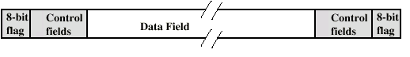
Synchronous (diagram)

Slide 12
Line Configuration
Topology
  Physical arrangement of stations on medium
  Point to point
  Multi point
    Computer and terminals, local area network
Half duplex
  Only one station may transmit at a time
  Requires one data path
Full duplex
  Simultaneous transmission and reception between two stations
  Requires two data paths (or echo canceling)

Slide 13
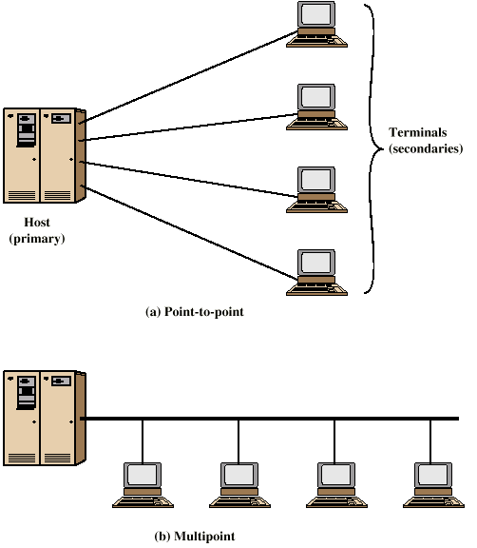
Traditional Configurations

Slide 14
Interfacing
Data processing devices (or data terminal equipment, DTE) do not (usually) include data transmission facilities
Need an interface called data circuit terminating equipment (DCE)
  e.g. modem, NIC
DCE transmits bits on medium
DCE communicates data and control info with DTE
  Done over interchange circuits
  Clear interface standards required

Slide 15
Characteristics of Interface
Mechanical
  Connection plugs
Electrical
  Voltage, timing, encoding
Functional
  Data, control, timing, grounding
Procedural
  Sequence of events

Slide 16
V.24/EIA-232-F
ITU-T v.24
Only specifies functional and procedural
  References other standards for electrical and mechanical
EIA-232-F (USA)
  RS-232
  Mechanical ISO 2110
  Electrical v.28
  Functional v.24
  Procedural v.24

Slide 17
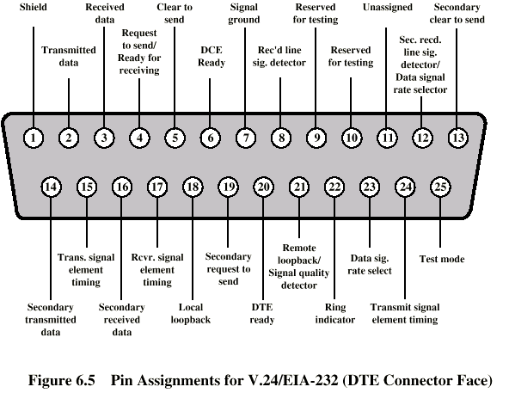
Mechanical Specification

Slide 18
Electrical Specification
Digital signals
Values interpreted as data or control, depending on circuit
More than -3v is binary 1, more than +3v is binary 0 (NRZ-L)
Signal rate < 20kbps
Distance <15m
For control, more than-3v is off, +3v is on

Slide 19
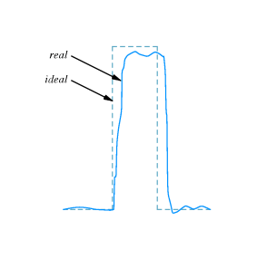
Impairments to RS-232 Transmission
Resistance (attenuation)
Capacitance of the cable
Inductance
Near-end Cross-talk (NEXT)

Slide 20
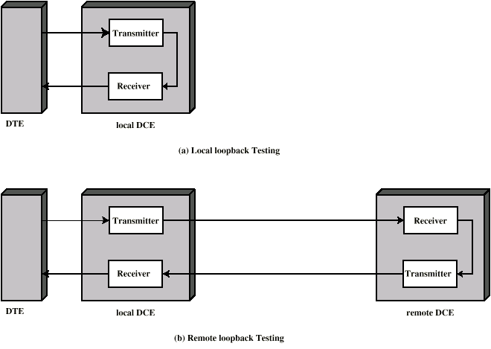
Local and Remote Loopback

Slide 21
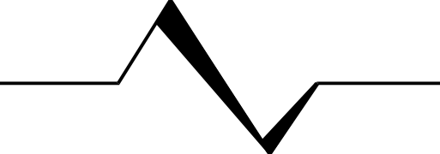
Bit Error Rate Testing
Circuit Under
Test
Pattern
Generator
Comparator
All ones
Alternating one-zero
Quasi-random patterns
Low-ones density
Programmable
Pattern Sensitivity

Slide 22
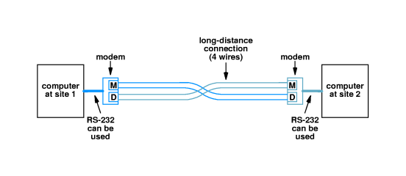
Modem Hardware
8
2
9
8
2
9
CO
Loopback Unit

Slide 23
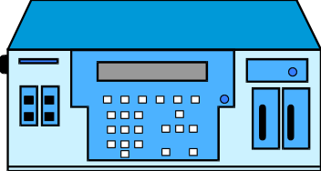

Analog Circuit Testing at CO
8
2
9
2713 Hz loopback
1004 Hz test
OSS
Switched Metallic Access
System (SMAS)

Slide 24
Procedural Specification
E.g. Asynchronous private line modem
When turned on and ready, modem (DCE) asserts DCE ready
When DTE ready to send data, it asserts Request to Send
  Also inhibits receive mode in half duplex
Modem responds when ready by asserting Clear to send
DTE sends data
When data arrives, local modem asserts Receive Line Signal Detector and delivers data

Slide 25
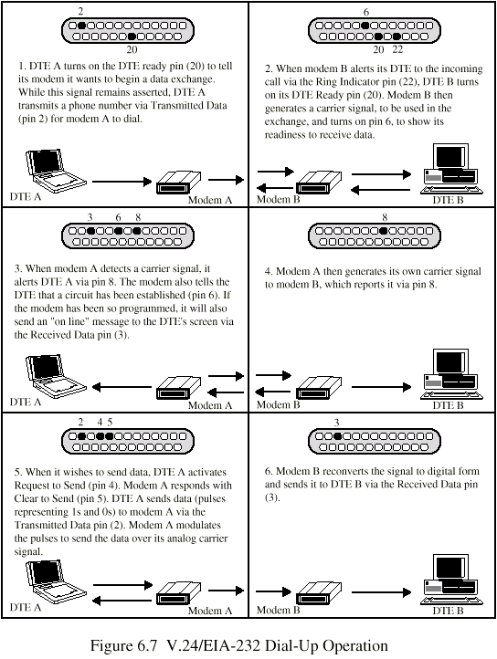
Dial Up Operation (1)

Slide 26
Dial Up Operation (2)

Slide 27
Dial Up Operation (3)

Slide 28
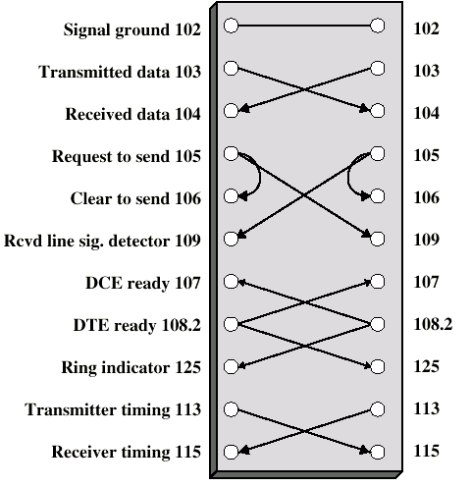
Null Modem

Slide 29
EIA RS-449 Interface
0-2 megabits/sec.
distance limitation dependent on speed
37-pin D-subminiature connector
balanced interface

Slide 30
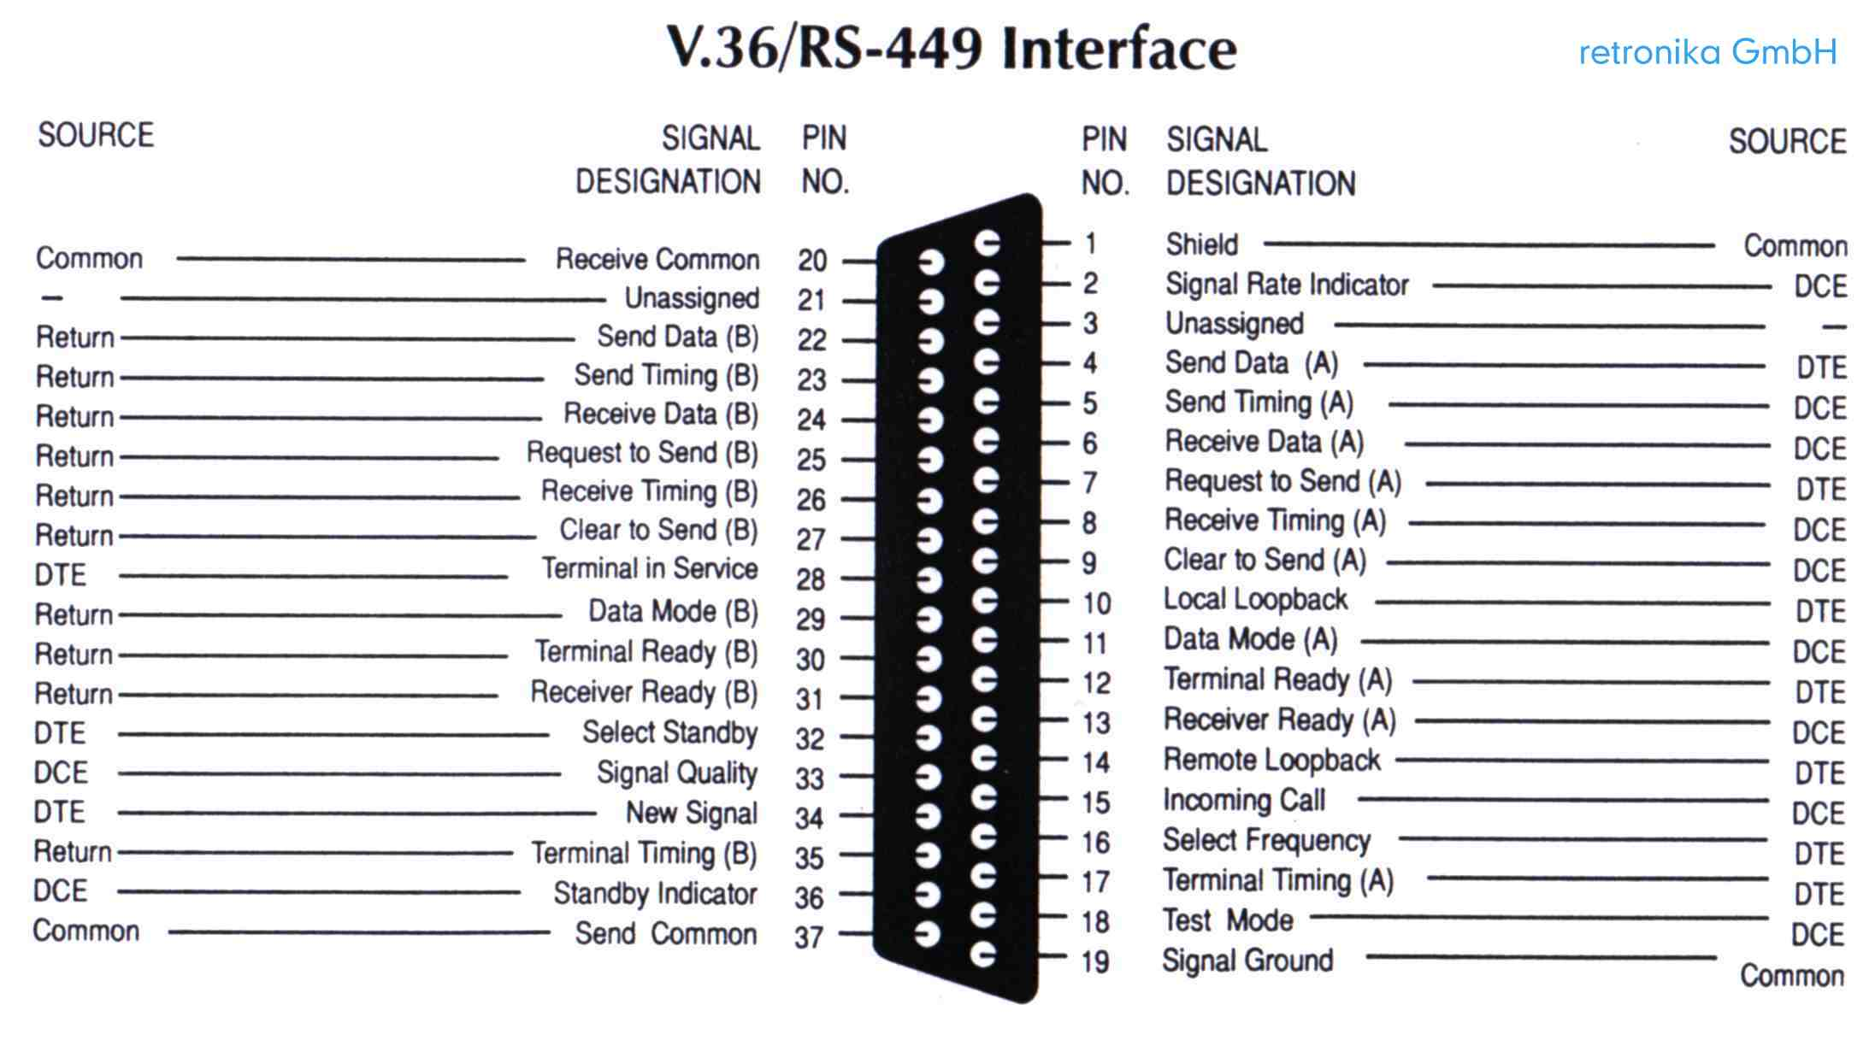
RS-449 Pinout

Slide 31
ISDN
Integrated Services Digital Network
  Part of a network architecture
  Definition for the access to the network
  Allows access to multiple services through a single access
Standards-based
  ITU recommendations
  Proprietary implementations

Slide 32
Terminology
B Channel “Bearer Channel”
  64 Kbps
  Carries information (voice, data, video, etc)
  DS-0

Slide 33
Terminology (Cont.)
D Channel “Signaling Channel”
  16 Kbps or 64 Kbps
  Carries instructions between customer equipment and network
  Carries information
  Can also carry packet switch data (X.25) for the public packet switched network

Slide 34
Terminology (Cont.)
BRA/BRI (Basic Rate Access/Basic Rate Interface)
  2 B + D
  2 x 64 Kbps + 16 Kbps = 144 Kbps (not including overhead)
  designed to operate using the average local copper pair

Slide 35
Terminology (Cont.)
PRA/PRI (Primary Rate Access/Primary Rate Interface)
  23 B + D
  23 x 64 Kbps + 64 Kbps = 1.536 Mbps (not including overhead)
  Designed to operate using DS-1/E1
  In Europe 30 B + D
  Optional backup D channel.

Slide 36


Network Architecture
Common Channel
Signalling Network and
Database
PRA
Telco
Switch
Circuit Switched Services
Telco
Switch
ISDN
PBX
BRA
NT1
Dedicated Circuit Services
Public Packet
Network

Slide 37


ISDN Reference Points
NT1
  Terminates local loop
  Coding and transmission conversion
  Maintenance and performance monitoring
  Consider as a CSU
NT1
U
S

Slide 38
Access to ISDN
At the S-reference point:
  RJ-45 (receive and transmit pair)
  Optional power can be provided for TE devices
  Distance:
    1 Km (1 x TE only), 200 m (8 x TE), 500 m (4 x TE)
  When more than 1 TE, wires act as a bus
    CSMA/CD
  Limitation: cannot have an extension phone

Slide 39
Access to ISDN
At the U-Reference point (BRA)
  Standards differ NA, France, UK vs. Germany
  vs. Japan
  In North America, designed to use as much of existing copper plant available
    2 wire, unloaded local loops are 99% of total
  Up to 5.5 Km loop length
At the U-Reference point (PRA)
  DS-1 standard

Slide 40
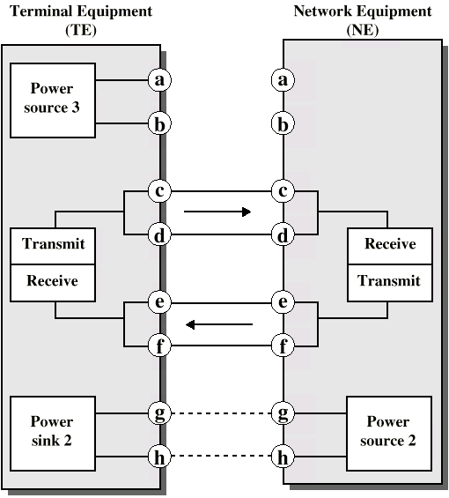
ISDN Physical Interface Diagram

Slide 41
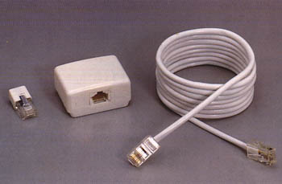
ISDN Physical Interface
Connection between terminal equipment (c.f. DTE) and network terminating equipment (c.f. DCE)
ISO 8877
Cables terminate in matching connectors with 8 contacts (USOC RJ45)
Transmit/receive carry both data and control

Slide 42
ISDN Electrical Specification
Balanced transmission
  Carried on two lines, e.g. twisted pair
  Signals as currents down one conductor and up the other
  Differential signaling
  Value depends on direction of voltage
  Tolerates more noise and generates less
  (Unbalanced, e.g. RS-232 uses single signal line and ground)
  Data encoding depends on data rate
  Basic signaling rate 192kbps (144 kbps usable)
  Primary rate uses alternative mark inversion (AMI) and B8ZS

